Slide 1
Geometry Homography & SFM
Class 5-6

Slide 2
Today
Stereo:
Rectification, matching, other stereo pairs
Special cases:
planar surfaces, camera rotation
Structure from motion (SFM)
Tools:
Homography transformation, RANSAC, SVM

Slide 3
Rectification
Simplify the use of epipolar lines
u
P
p_{l}
p_{r}
C_{l}
C_{r}

Slide 4
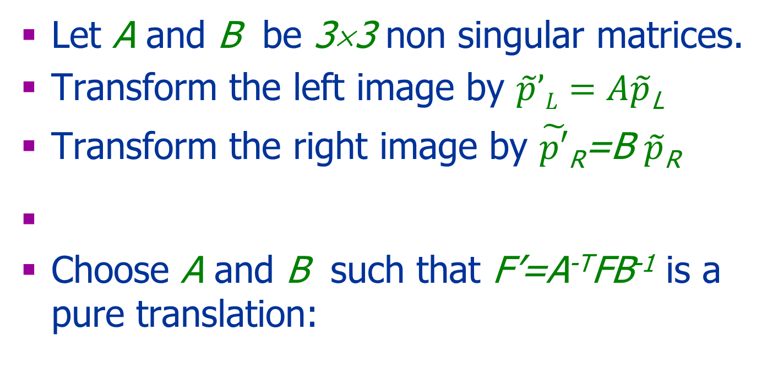
Rectification
Let A and B be 3×3 non singular matrices.
Transform the left image by $\tilde{p}’L=A\tilde{p}$_{L}
Transform the right image by $\tilde{p′}$_{R}=B $\tilde{p}$_{R}
Choose A and B such that F’=A^{-T}FB⁻¹ is a pure translation:

Slide 5
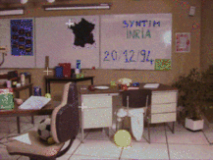
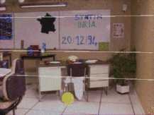
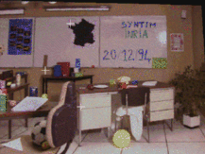
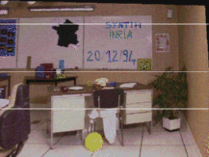
Rectification
Taken from: SYNTIM-INRIA.

Slide 6
More on Correspondence

Slide 7
Correspondence
Similarity of patches
Geometric constraints:
Epipolar geometry
Global constraints:
Shape smoothness
Order preserving
..

Slide 8
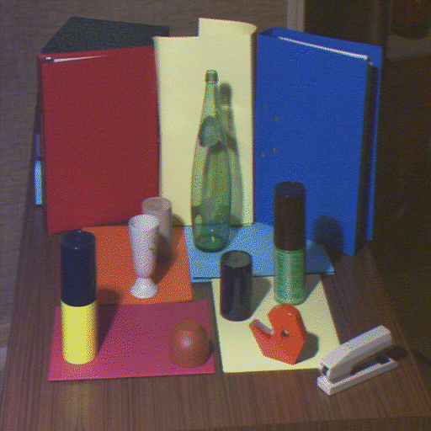
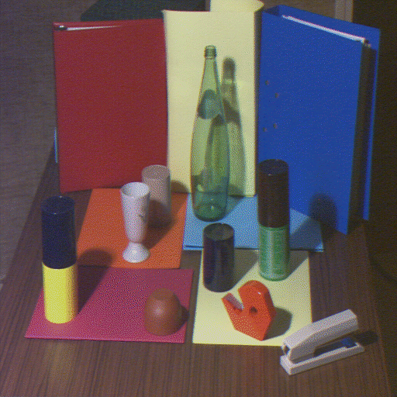
Points Attribute Constraints
A pair of corresponding points must have the same physical origin
Both are located on an edge due to a surface discontinuity, a shadow border, an occluding boundary, etc.

Slide 9
Occlusion
Occluded in
Right Image
Occluded in
Left Image
Right
Left
+
+
Center of
projection
Center of
projection

Slide 10
Uniqueness Constraint
Each pixel can correspond to at most one pixel in the other image
No transparency
No two or more points
project to the same point

Slide 11
Ordering Constraints
Corresponding points of similar depth typically maintain their order on the epipolar lines
This assumption does not hold when there is a depth discontinuity
p
q

Slide 12
Disparity Smoothness Constraint
The disparity changes slowly almost everywhere in the image
True since the depth changes slowly almost everywhere in the 3D scene

Slide 13
Mutual Correspondence Constraint
The existence of a correspondence between points does not depend on whether we start from the left image or the right image

Slide 14
Correspondence Optimization
Local greedy matches:
Low-level: Bottom up methods are based on local attributes of points
1D search
2D search:
High-level: Minimizing an energy function that represents global and local properties of the surface (e.g., smoothness)

Slide 15

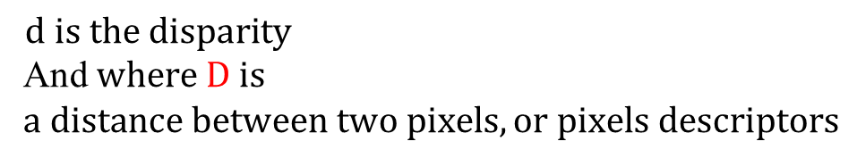
High Level Energy Function
Assume rectified images:
weight
$$D$$
Data Term
Regularization
$$d is the disparity$$
And $where D is$ $$a distance between two pixels, or pixels descriptors$$

Slide 16
1D: Dynamic Programing
Right
occlusion
p
Left occlusion
correspondence
t
s
q

Slide 17
Other Pairs of Images

Slide 18
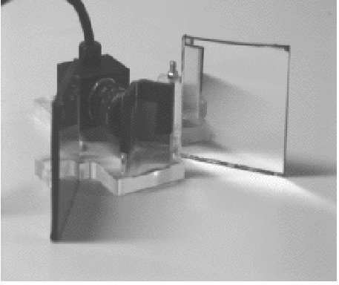
Mirrors
Taken from Mathieu and Devernay INRIA

Slide 19
Structured Light
known camera and projector geometry
Depth can be recovered by triangulation

Slide 20
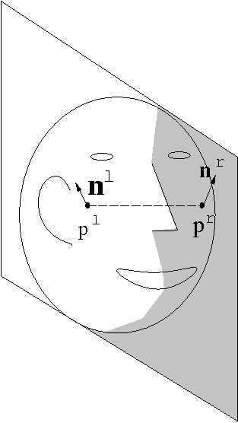
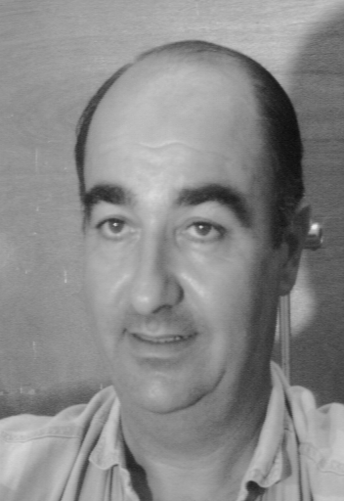
Bilateral Symmetry

Slide 21
Uncalibrated Stereo
Calibration is necessary to determine absolute 3D positions
We can determine relative 3D positions (up to a scale factor) without calibration

Slide 22
What if we do not know the external parameters?
P
The disparity:
d =x_{l}-x_{r}
Z
O_{L}
O_{r}
x_{l}
x_{r}
f_{l}
p_{l}
p_{r}
f_{r}=f_{l}
T
cop_{l}
cop_{r}

Slide 23
A Priory Knowledge
Intrinsic and extrinsic parameters
Intrinsic parameters
No information about parameters
3D-Reconstruction From 2 Views
Unambiguous
Up to unknown scaling factor
Up to unknown projective transformation

Slide 24
Stereo Summary
Triangulation
Correspondence
Epipolar geometry+ heuristics
Calibration
Remember: 3D reconstruction is possible only from 2 independent images

Slide 25
Next
Homography
More than 2 images:
Structure from motion
Other applications of Epipolar Geometry

Slide 26
Homography

Slide 27
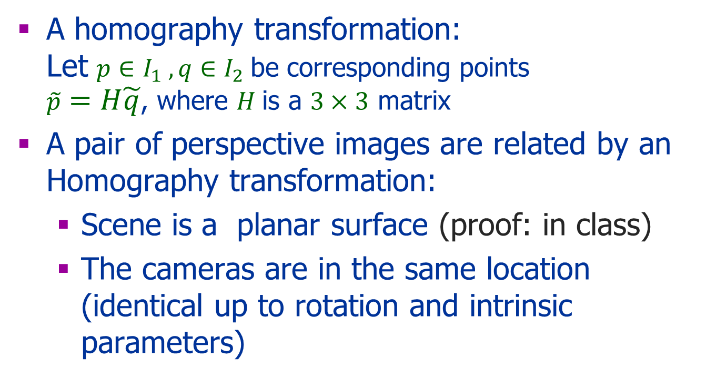
Homography
A homography transformation: Let $p∈I_{1} ,q∈I_{2}$be corresponding points $\tilde{p}=H\tilde{q}$, where $H$is a $3×3$ matrix
A pair of perspective images are related by an Homography transformation:
Scene is a planar surface (proof: in class)
The cameras are in the same location (identical up to rotation and intrinsic parameters)

Slide 28
Homography
Computing the Homography
Using the projection matrices (known plane)
Using 4 corresponding points
Using optical flow (later in the course)
Applications:
Mosaics: stitching images together
3D structure

Slide 29
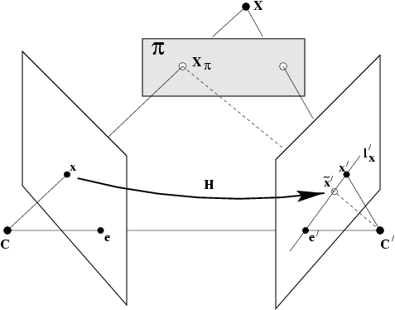
Plane-Induced Parallax: 3D Reconstruction
Decompose motion of scene points into two parts:
2D homography (as if all points coplanar)
Plane-induced parallax
Parallax: distance d relative to homography
d is proportional to
3D distance from plane
from Hartley & Zisserman

Slide 30
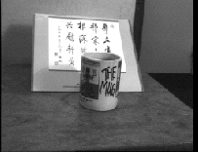
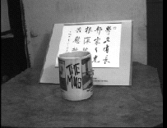
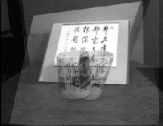
Plane-Induced Parallax
Left view superimposed on right using homo-graphy induced by plane of paper
Left view
Right view
from Hartley & Zisserman

Slide 31
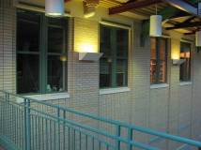
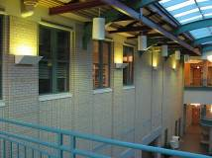
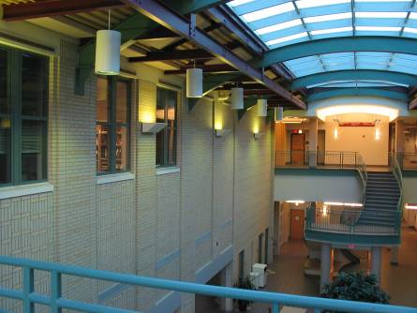
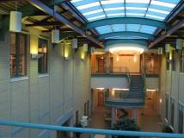
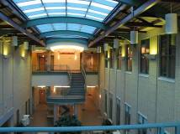
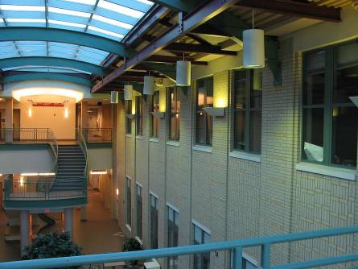
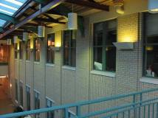
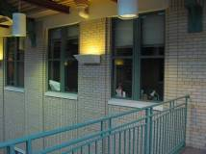
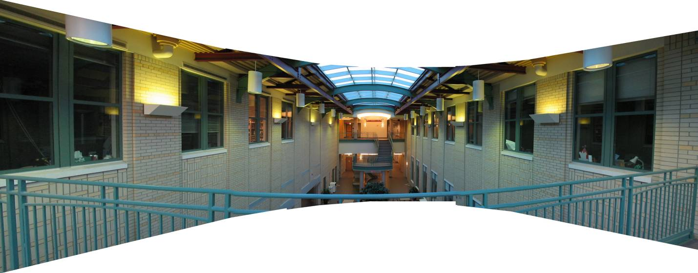
Homography: Pure Rotation
Taken from Jeffrey Martin
31
virtual wide-angle camera

Slide 32
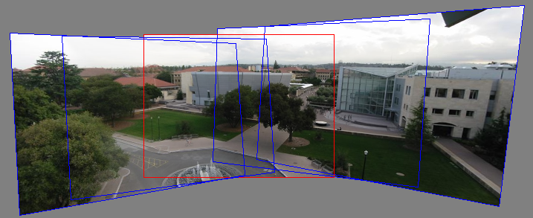
Panoramas
Pick one image (red)
Warp the other images towards it (usually, one by one)
blend
Taken from Jeffrey Martin

Slide 33
Multi-Camera Geometry
Multi-view stereo:
Improve correspondence
(e.g., use intersections of epipolar lines)
Structure from motion: more views but uncalibrated

Slide 34
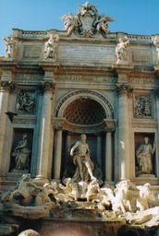
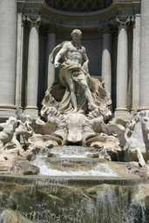
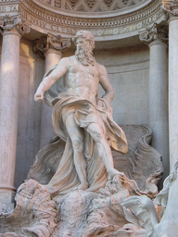
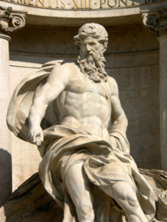
Structure From Motion

Slide 35
Structure from Motion
Assumptions:
A set of images
Uncalibrated
Applications:
Recover the camera locations
Photo Tourism
Improve robustness

Slide 36
Structure from motion
p₄
p₁
p₃
p₂
p₅
p₇
p₆
Camera 1
Camera 3
R₁,t₁
R₃,t₃
Camera 2
R₂,t₂
Slide by Seitz
Notes:
Structure from motion solves the following problem:
Given a set of images of a static scene with 2D points in correspondence, shown here as color-coded points, find…
a set of 3D points P and
a rotation R and position t of the cameras that explain the observed correspondences. In other words, when we project a point into any of the cameras, the reprojection error between the projected and observed 2D points is low.
This problem can be formulated as an optimization problem where we want to find the rotations R, positions t, and 3D point locations P that minimize sum of squared reprojection errors f. This is a non-linear least squares problem and can be solved with algorithms such as Levenberg-Marquart. However, because the problem is non-linear, it can be susceptible to local minima. Therefore, it’s important to initialize the parameters of the system carefully. In addition, we need to be able to deal with erroneous correspondences.

Slide 37
Structure from Motion
Given a sequence of images compute:
The structure
The motion (camera location)

Slide 38
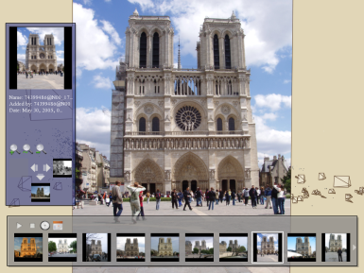
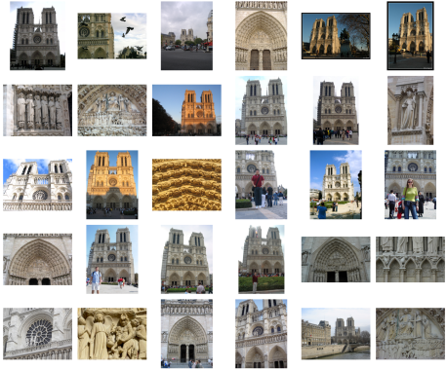
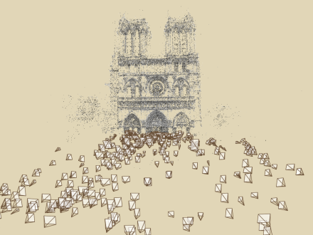
Application: Photo Tourism Overview
Photo Explorer
Scene reconstruction
Input photographs
Relative camera positions and orientations
Point cloud
Sparse correspondence
Photo Tourism: Exploring Photo Collections in 3D,
Snavely, Seitz, Szeliski
Slide by Seitz
Notes:
Our system takes as input an unordered set of photos, either from an Internet search or from a large personal collection. We assume the photos are largely from the same static scene.
The first step of our system is to apply a computer vision techniques to reconstruct the geometry of the scene. The output of this procedure is the relative positions and orientation for the cameras used to take a connected set of the photographs, as well as a point cloud representing the geometry of the scene, and a sparse set of correspondences between the photos.
This information is then loaded into our interactive photo explorer tool.

Slide 39
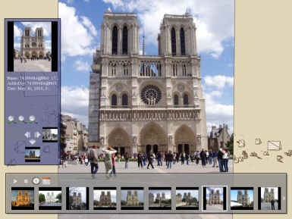
Photo Tourism Overview
Photo Explorer
Scene reconstruction
Input photographs
Slide by Seitz
Notes:
Now I will describe the Photo Tourism system, beginning with the scene reconstruction procedure.

Slide 40
Scene Reconstruction
Estimate
Projection matrices: position, orientation, and focal length of cameras
3D positions of feature points
Feature detection
Structure from motion
(incremental or other)
Pairwise
feature matching
Correspondence estimation
Slide by Seitz
Notes:
Again, the goal of the reconstruction procedure is to automatically estimate the relative positions and orientations, as well as the focal length or zoom, of each of the photographs in a connected component of the scene. The process consists of four steps: detecting features in each of the input photos; matching features between each pair of photos; grouping the matches into correspondences across multiple photos; and using the correspondences to estimate the geometry of the scene and the cameras in a technique known as structure from motion.
I’ll now describe each of these steps in more detail.
[Structure from motion techniques for unordered image collections have also been developed by others, such as Brown and Lowe and Schaffalitzky and Zisserman, and the basic pipeline of our system closely follows that of Brown and Lowe. To our knowledge, our system is the first to have been demonstrated on large collections of photos from the Internet.]

Slide 41
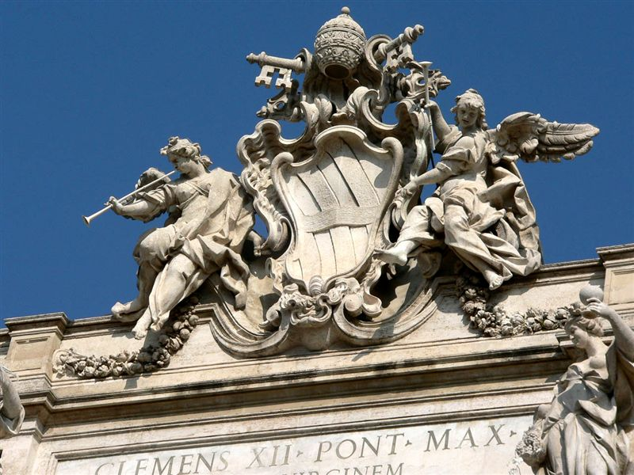
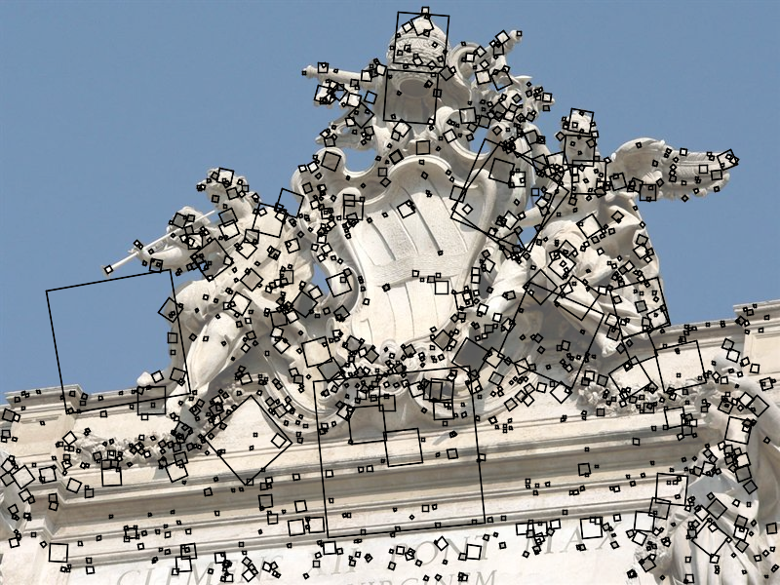
Feature Detection
Detect features using SIFT [Lowe, IJCV 2004]
Slide by Seitz
Notes:
The core of the reconstruction process is the ability to reliably match feature points between images. Fortunately, over the last few years feature detection and matching techniques have improved dramatically. Many different technique exist – we use SIFT, or scale-invariant feature transform, developed by David Lowe. SIFT is designed to be invariant to image scale and rotation, as well as affine changes in image intensity.
Here is an image from the Trevi Fountain, and here are the features SIFT detects in the image, shown as square patches. The squares are scaled and rotated to reflect the scale and orientation of the features.

Slide 42
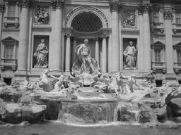
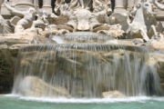
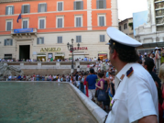
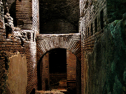

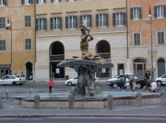
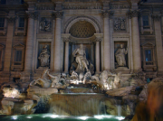


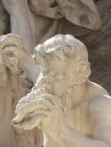
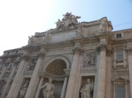
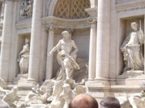
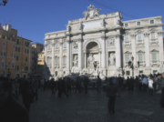

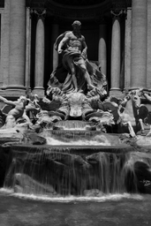
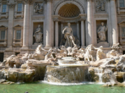
Feature Detection
Detect features using SIFT [Lowe, IJCV 2004]
Slide by Seitz
Notes:
So, we begin by detecting SIFT features in each photo.
[We detect SIFT features in each photo, resulting in a set of feature locations and 128-byte feature descriptors…]

Slide 43

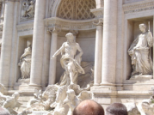
Feature Detection
Detect features using SIFT [Lowe, IJCV 2004]
Slide by Seitz

Slide 44


Feature Matching
Match features between each pair of images
Slide by Seitz
Notes:
Next, we match features across each pair of photos using approximate nearest neighbor matching.

Slide 45

Feature matching
Refine matching using RANSAC [Fischler & Bolles 1987] to estimate fundamental matrices between pairs
Slide by Seitz
Notes:
The matches are refined by using RANSAC, which is a robust model-fitting technique, to estimate a fundamental matrix between each pair of matching images and keeping only matches consistent with that fundamental matrix.
We then link connected components of pairwise feature matches together to form correspondences across multiple images.
Once we have correspondences, we run structure from motion to recover the camera and scene geometry. Structure from motion solves the following problem:

Slide 46
Class 6
Continue SFM
Motion analysis (different set of slides)

Slide 47
RANSAC
RAndom SAmple Consensus
An iterative method to estimate parameters of a model from a set of observed data which contains outliers, e.g.,
A set of points a line
A set of corresponding points fundamental matrix
A set of corresponding points Homography

Slide 48
RANSAC
Assumption:
The model can be computed from a small set of points
The set of points consists of inliers and outliers
Challenges:
which points to use?
When to stop?

Slide 49
RANSAC
Iteratively selecting a random subset of points:
Fit a model
Test with the entire set: inliers and outliers
Support set: sufficient large number of inliers
Repeat the model computation

Slide 50
Correspondence Estimation
Run RANSAC
Compute set of correspondence, e.g., by:
Use transitivity - connected components
Use cliques
Image 1
Image 2
Image 3
Image 4
Slide by Seitz
Notes:
The next step of our reconstruction algorithm is to link up matches between pairs of images into correspondences between multiple images, by finding connected components of matches. Suppose among these images, these features are matched only between consecutive pairs of images, perhaps because the scales of the images are so different. During correspondence estimation we link these matches and consider them to be 2D projections of a single 3D point in the scene.

Slide 51
Affine Structure from Motion
The Problem:
Reconstruct scene geometry and camera motion from two or more images
Assumptions:
Known correspondence
Orthographic projection

Slide 52
Affine Transformation
Translation, rotation, nonuniform scaling, shear
Parallel lines remain parallel
Lengths, areas, angles are lost

Slide 53
Orthographic+ Scale Projection
Let P be an object point and p be an image point then , where
R is a 3x3 rotation matrix
s is a scale factor
T is a translation vector
Define that is M is a 2x3 matrix
In this case , where b=MT

Slide 54
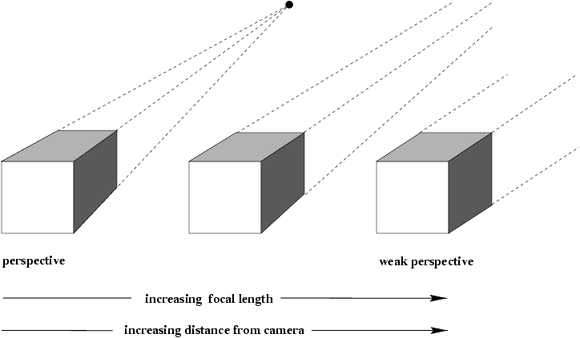



Slide 55
Get Rid from Translation
Let p_{i0} be the projection of the object point P₀ in image i
Translate all image points of image i : q_{ij} →p_{ij}- p_{i0}
We now have
instead of

Slide 56
Tomasi - Kanade
A factorization algorithm to solve SFM
Based on SVD
Reference:
• Forsyth and Ponce book: Section 14.3
• Carlo Tomasi and Takeo Kanade, “Shape and motion from image streams under orthography: a factorization method,” International Journal of Computer Vision, 9(2):137-154, November 1992.

Slide 57


Slide 58

Set Up
n unknown object points,
3n unknowns
m unknown cameras,
6m unknowns
mn known images of the object points
2mn equations – non-linear!

Slide 59
Ambiguity
Let M_{i} and P_{j} be a solution to
Let B be a non singular 3x3 matrix (affine transformation)
M_{i}’=M_{i}B and P_{j}’=B⁻¹P_{j} is also a solution

Slide 60
Using Matrix Notation
Consider the set of projection of a point P_{j} into m images:
₌
2mx1
2mx3

Slide 61
Consider n points P_{i}
where
₌
2mxn
2mx3
3xn
Ambiguity

Slide 62

SVD: Singular Value Decomposition
Let A be an $kl$ matrix with A=UDV^{T} where:
U is an k×k column orthonormal matrix
U^{T}U=I
D is a diagonal matrix, $kl$
V is an $ll$orthonormal matrix
V^{T}V=I

Slide 63
SVD
The columns of U, are the eigenvectors of AA^{T}
The columns of V , are the eigenvectors of A^{T}A
The elements of D, are the square roots of A^{T}A eigenvalues (singular values)
Which are the same as the square roots of and AA^{T}
The singular values appear in decreasing order

Slide 64
The Algorithm
Compute the singular value decomposition: Q=UDV^{T}
Compute U_{3 ’} V₃ and D₃
M₀=U₃ and P₀= D₃ V₃^{T}
M₀ is the camera motion estimation
(2mx3 parameters)
P₀ is the 3D point estimation
(3n parameters)

Slide 65
Questions
Can we choose a rigid solution?
What are the assumptions we made about the objects in the scene?
How can we solve the ambiguity?
How correspondence outliers expect to affect the algorithm?

Slide 66



Incremental SFM
Trevi Fountain,
Rome
Slide by Seitz
Notes:
To help get good initializations for all of the parameters of the system, we reconstruct the scene incrementally, starting from two images, then adding images one at a time. To begin, we automatically find a pair of images with many correspondences and which seem to have a large baseline, in order to get well-conditioned estimates of the parameters.
Here is the initial pair of images our system chose from the Trevi Fountain set. The images are similar enough to have a lot of features, but there is some distance between the cameras – the first camera is below the lip of the fountain and the second camera is above it. We first initialize these images to the origin…

Slide 67



Incremental SFM
Optimize parameters for two cameras and common points
Find new image with most matches to existing points
Initialize new camera using pose estimation
Bundle adjust
Add new points
Bundle adjust
Slide by Seitz
Notes:
and initialize the points observed by the images to a fixed depth from the cameras. We then run a non-linear optimization to refine the point locations and camera parameters.
Next, we add a new image to the optimization, choosing the image that observes the most existing 3D points. The parameters of the new camera are initialized using pose estimation, then a global refinement is run again. Finally, we add new points to the scene observed by at least two cameras using triangulation.

Slide 68

Incremental SFM
Slide by Seitz
Notes:
To help get good initializations for all of the parameters of the system, we reconstruct the scene incrementally, starting from two images, then adding a small number of images at a time.
Here’s a video of the incremental reconstruction of the Trevi Fountain photo set, starting from two cameras, and growing to a total of 350 cameras.
The process terminates when no more images has any matches to points in the scene.

Slide 69






Perspective Projection: Incremental SFM
Slide by Seitz
Notes:
To help get good initializations for all of the parameters of the system, we reconstruct the scene incrementally, starting from two photographs and the points they observe.

Slide 70

Incremental SFM
Slide by Seitz
Notes:
To help get good initializations for all of the parameters of the system, we reconstruct the scene incrementally, starting from two photographs and the points they observe.

Slide 71

Incremental SFM
Slide by Seitz
Notes:
We then add several photos at a time to the reconstruction, refine the model, and repeat until no more photos match any points in the scene.

Slide 72

Photo Tourism overview
Photo Explorer
Scene reconstruction
Input photographs
Slide by Seitz
Notes:
Once we reconstruct a scene, we can view it in our photo explorer. I’ll now describe the explore, starting with a demo of the system.

Slide 73

Photo Explorer
Slide by Seitz

Slide 74
Summary
Projection models:
Perspective & Weak perspective
Algebraic formulation:
Projective geometry
Tasks:
Stereo
Homograph
SFM

Slide 75

Stereo SC

Slide 76





